Slide 1

Poolify : Your Smart Commute Solution
Group members with Student Id
1. Nishant Chauhan – 23107010
2. Nikhil Anumalla – 23107055
3. Sneha Edugunoori – 23107011
4. Chinmay Ghosh - 23107001
Project Guide
Ms. Poonam P

Slide 2
Content
Introduction
Objectives
Scope
Features / Functionality
Project Outcomes
Technology Stack
Block Diagram

Slide 3
Introduction
POOLIFY is a ride-sharing app designed to offer affordable, eco-friendly transportation by connecting passengers traveling in the same direction. It aims to reduce traffic, and make commuting convenient for all.
It’s not just a ride-sharing app—it’s a movement toward smarter, greener cities.

Slide 4
Introduction
➢ Problems Identified
  • Underutilization of vehicles : Many private vehicles carry only one or two passengers, leading to inefficiency.
  • Inefficient public transportation : Public transport often lacks reliability and convenience. Overcrowding and lack of last minute connectivity.
➢ Solutions Proposed
  • Affordable pricing model : Dynamic pricing to balance demand and supply while avoiding overcharging.
  • Convenience and reliability : Provide a user-friendly desktop application for booking and generating rides with minimal efforts.

Slide 5
Objectives
User Registration & Role-Based Features
2. Ride Management & Booking System
3. Profile & Account Management
4. Interactive Chatbot Assistance
5. Data Management & Platform Usability

Slide 6
Scope
Can be applied in corporate sectors to facilitate employee carpooling, reducing costs and parking issues.
Can be beneficial for senior citizens and differently-abled individuals by offering accessible, and reliable.
Can be applied in urban and suburban areas to reduce traffic congestion and improve commuting efficiency. Can be applied to reduce peak-hour traffic by optimizing shared rides in high-demand areas.
Can support delivery and logistics services by optimizing routes and sharing transport costs for small-scale deliveries.

Slide 7
Features / Functionality
1. Trip Creation (Driver):
• Drivers can create trips by entering origin, destination, date, time,and available seats.
2. Ride Booking (Passenger):
• Passengers can easily book available seats, with real time updates to seat availability.
3. Interactive Maps:
• Visualize pickup/drop points and routes using Google Maps.
4. Interactive Chatbot:
    Users can easily interact with the bot for their doubts/support.

Slide 8
Outcome of Project
1. User Can Sign Up and Log In : Users can create an account and log in securely to access the app features.
2. User Can Book a Ride by Providing Inputs : Users can specify: Pickup and drop-off locations and Number of passengers.
3. User Can View Transaction History : Access to past payments, and details for reference.
4. AI-Powered Chatbot Support : Respond to user queries about booking, wallet balance, ride status, etc.

Slide 9
Technology Stack
1. Frontend – Python (Tkinter).
2. Backend – MySQL.
3. API’s – Google Static Maps, Google Maps Direction, Google Direction Matrix.

Slide 10
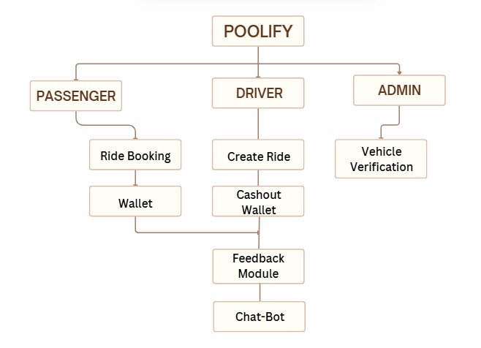
Block Diagram

Slide 11
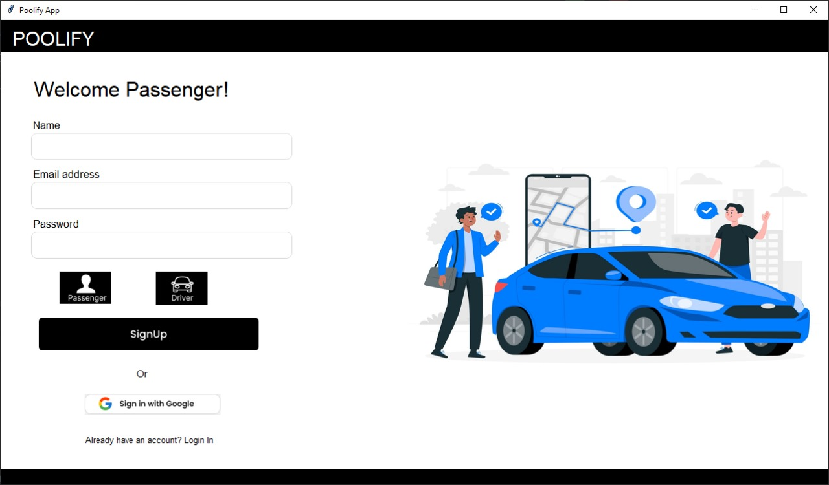

Slide 12
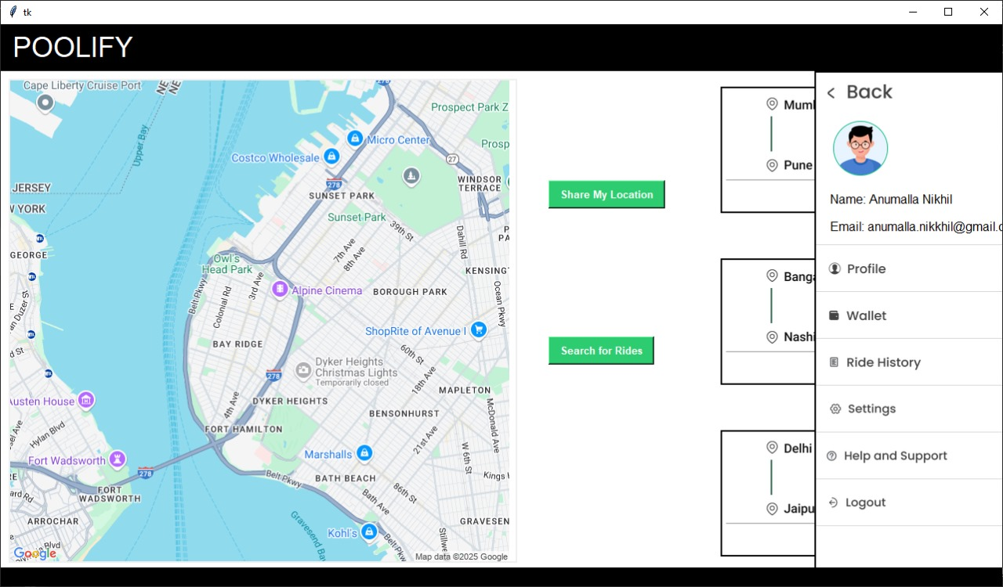

Slide 13
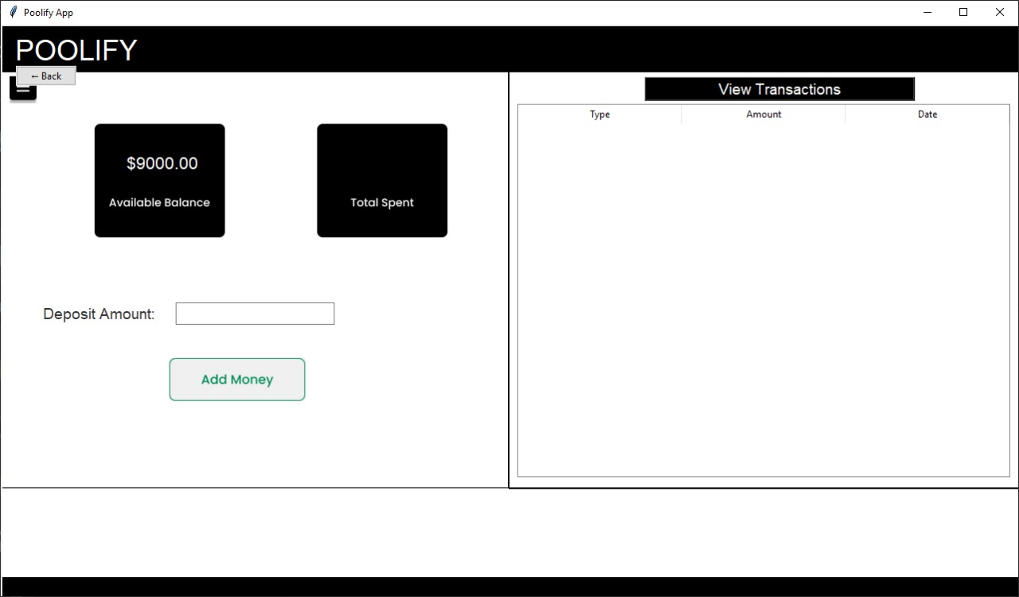

Slide 14
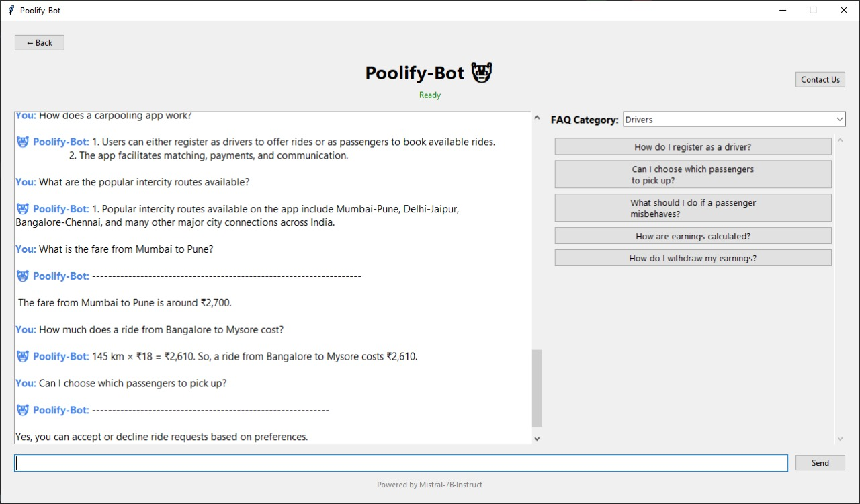

Slide 15
